Slide 1

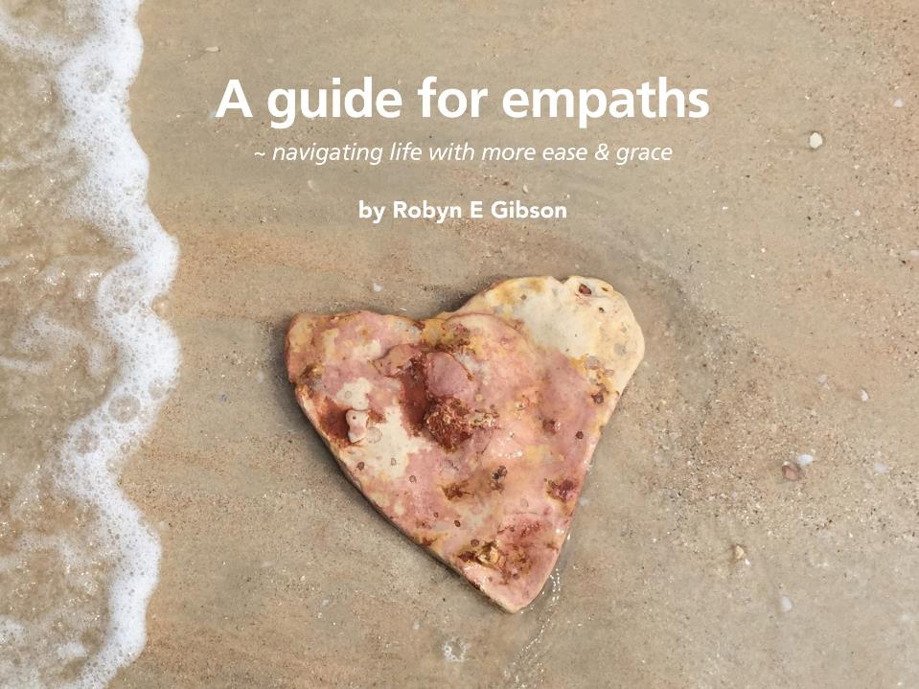

Slide 2
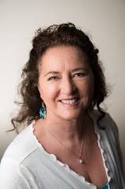
About Robyn
Transformation Teacher, Grand Master of online healing
energy programs called
  Conscious Light – system of natural healing, and
  Higher Communications – visual guided meditations.
Having practiced healing energy techniques naturally as a young woman, she introducing this work to others when she could see they needed a helping hand.
Always teaching those interested whatever she had learned - as her guide explained to her:
“When you learn something new, you must teach it!”
She also loves freshly made vanilla slices (the messier the better.)

Slide 3
How to uplift how you feel | Heart Healing Retreat
This presentation is created so you can experience the eBook ‘Guide for Empaths’ and the visual meditations in the ‘Align’ Module of Higher Communications in a fun and easy way.
After you have experienced the Retreat yourself, you may like to have a friend over to enjoy this with, or invite a group to play together.
Either way, it’s fun!
Come join our tribe on the Higher Communications Chat Group to share your successes, inspire each other and ask questions.

Slide 4
Invocation
I ask for the Angels and Archangels to please create for us a crystalline temple of light for around us.
I invite each of our high level guides, Angels, Masters and Great Beings of light to please join us.
I ask that you clear and cleanse all energies that are not of the light from all of us and that we, for each of us, the radiant light, be filled with the raised vibrations needed for our healing, growth and our light.

Slide 5
My Intention
These processes in this retreat alone, when practiced regularly, is enough to transform your life forever.
Starting at the beginning with Meditation 1 ‘Letting your thoughts go’ together with easy statements, commands and techniques - they are powerful beyond measure in uplifting how you feel.

Slide 6
The first step
Your happiness is the best gift you can ever give – to yourself, and to others.
When you’re not happy, you have a choice:
Acknowledge that you’re unhappy and stay there.
Acknowledge that you’re unhappy and make a change.
Intending to love and look after yourself is the first step to change.

Slide 7
Start with affirming…
It is my dominant intent to love and look after me!

Slide 8
Loving yourself
We are human beings experiencing life. These experiences can create a range of emotions which challenge loving ourselves.
Instead of trying to ‘Love Yourself’…..
Focus your attention on the part of you which loves
Let’s practice.

Slide 9
Sensitive people or Empaths
Sensitive people are important to our society, because they are the leaders of the future (known or unknown to the masses!)
They are affected by the feelings and energies of people around them.
When sensitive people learn to amplify their light, they are then ready to progress further to their leadership role.
Sensitive people are the leaders needed for humankind’s evolution.
Now is the time to amplify your light, so let’s begin.

Slide 10
There is power in the universe
You can call this power anything, God, Goddess, All that Is, The Universe, Consciousness, Source of all Creation etc. The name isn’t important, it’s still the same power.
Asking for help and connecting to this power helps you to
Feel peaceful inside.
Make wise choices.
Receive and give love.

Slide 11
Allow this power in your life - using your breath.
Deep breath in commanding:
‘Quantum in breath of allowing’
– meaning ‘unlimited allowing of all that is for your highest good’
Deep breath out commanding:
‘Disintegrate and remove all negative thoughts and negative beliefs NOW!’
– you don’t need to carry those any more.

Slide 12

Meditation 1 – Letting your thoughts go

Slide 13
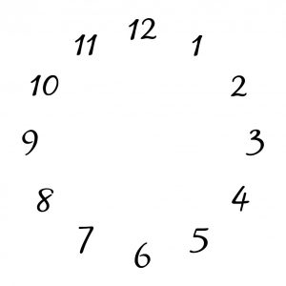
Uplift your thoughts
I don’t have to think about that!
The clock face technique.

Slide 14
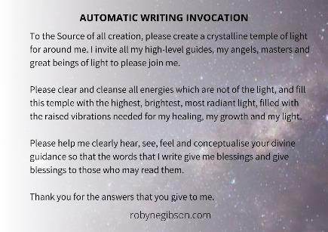
Automatic Writing Practice
“What is one ease step I can take to love and look after me?”

